Slide 1
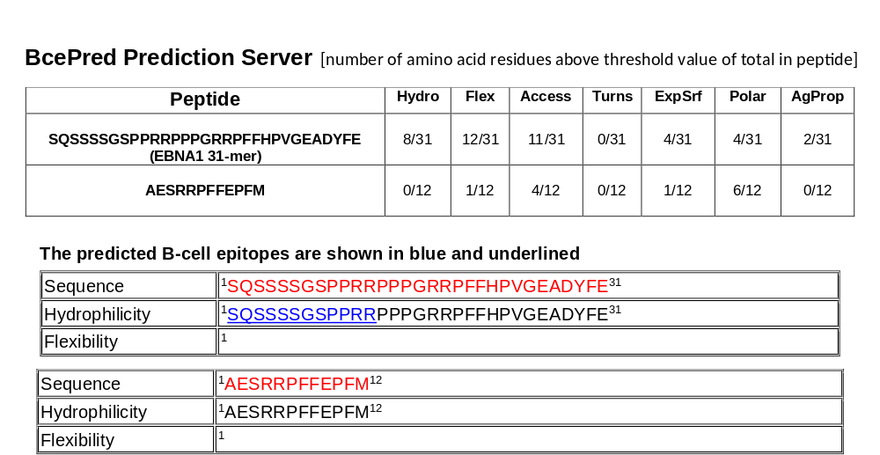
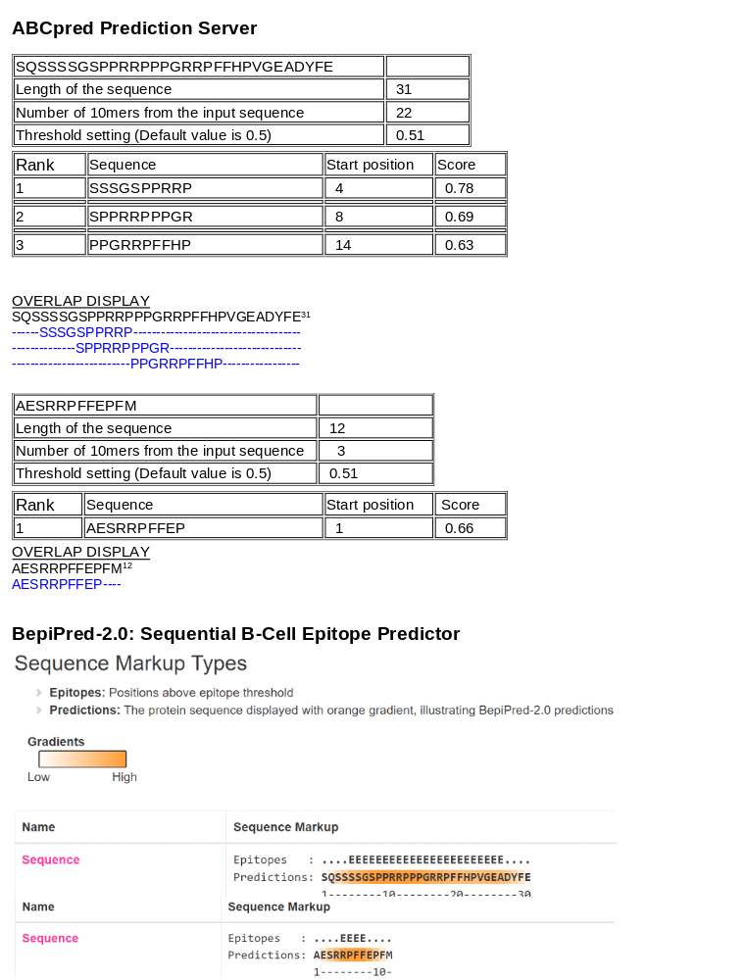
Supplemental Figure 1
A
B

Slide 2
Supplemental Figure 1, cont
C

